Slide 1

SIGMA SOFTWARE
Weather-zone
Created by:
Ivan Baranetskiy, Mykola Anufriiev, Anton Samsonov, Maksim Dzyba, Tymofii Bortsov, Bohdan Dienin, Maxim Babichiev
And our mentor Dmitriy Maltsev

Slide 2
About Project
—
The theme - “weather forecast”
Main goal was to get acquainted with REST and OpenAPI
Application allows to get weather by user’s location
User can receive forecast for up to 10 days ahead

Slide 3


Application architecture
—
Weather Open API
Weather API
Weather service
Mongodb
User
Forecast API
Forecast service
Postgres
User API
User service
Admin

Slide 4


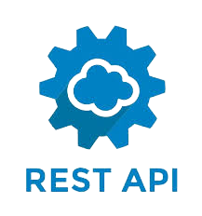





Technology Stack
—

Slide 5

Spring —
Universal open source Java framework
Ease of use
Aspect oriented programming using Java annotations
Enjoyable Inversion of Control and Dependency injection

Slide 6

Spring Boot —
Create stand-alone Spring applications
Embed Tomcat, Jetty or Undertow directly (no need to deploy WAR files)
Provide opinionated 'starter' dependencies to simplify your build configuration
Automatically configure Spring and 3rd party libraries whenever possible
Provide production-ready features such as metrics, health checks, and externalized configuration
Absolutely no code generation and no requirement for XML configuration

Slide 7

Spring Data —
Powerful repository and custom object-mapping abstractions
Dynamic query derivation from repository method names
Implementation domain base classes providing basic properties
Support for transparent auditing (created, last changed)
Possibility to integrate custom repository code
Easy Spring integration via JavaConfig and custom XML namespaces
Advanced integration with Spring MVC controllers
Experimental support for cross-store persistence

Slide 8
MongoDB —
PostgreSQL —
Fast database
Pretty old and stable
Open-source support and corporate support
One of the most agile NoSQL DB
Highly expandable
Largely compliant with SQL standards
Possible to process complex data types
Flexible full text search

Slide 9
DB refactoring: Flyway vs Liquibase —
Flyway has the out-of-the-box integration in Spring Boot
Uses SQL or Java code as migration scripts
Highly customizable scripts for effective work
Uses XML, YAML and JSON for scripts
Changes in the database at the abstraction level
More flexibility when working with different DB types

Slide 10
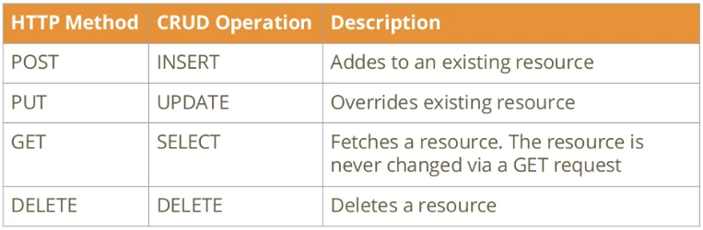
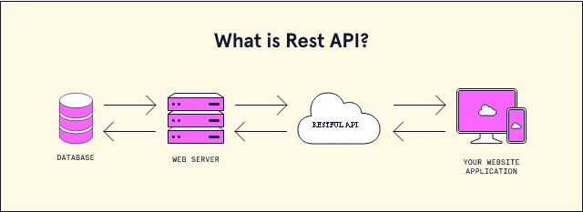
Rest Api Client —

Slide 11
RestTemplate
—
Feign
—
Simplified RESTful Web Services interaction on client side
A lot of things we don't need to care about because they happen in the background
Deals with JSON/XML transformation of entities
Easy to implement
No need to change business logic
Doesn’t need unit tests, but integration tests are must have

Slide 12

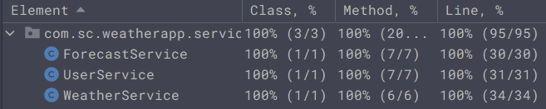
Unit Tests —
Open-source framework
Write and execute automated test
Identify invalid situations and log it
Simplifying debugging process
Provides error documentation

Slide 13
Demonstration —

Slide 14

Q/A

Slide 15
THANK YOU FOR ATTENTION!

